Slide 1
Statutory Consultation Meeting
29 March 2023
Proposed establishment of a new primary school and its associated catchment area within the land at Easthouses and the realignment of the catchment areas of Dalkeith High School, Newbattle High School and Lasswade High School.

Slide 2
Agenda
Welcome and Introductions
Format and purpose of meeting
Statutory Consultation Process
The Proposal
Educational Benefits
Questions
Close and Thanks

Slide 3
Panel/Introduction
Mike Gibson Independent Chair
Fiona Robertson Executive Director Children, Young People
& Partnerships
Michelle Strong Education Chief Operating Officer
Ross Irvine Senior Project Manager
Jennifer Allison Head Teacher
Midlothian Council Officers
Education Scotland Observers
Project Team

Slide 4
Statutory Consultation Process
The duties placed on local authorities in relation to the adequate and efficient provision of school education in their area in the Education (Scotland) Act 1980
The responsibilities associated with the National Improvement Framework and the new duties imposed on Education Authorities by the Standards in Scotland’s Schools etc. Act 2000 as amended by the 2016 Act
The duties placed on local authorities to secure best value in the delivery of services

Slide 5
Statutory Consultation Process and Timeline
Consideration by Midlothian Council - May 2018, approval to undertake a statutory consultation
Proposal Paper including Educational Benefits Statement published 27th February 2023
Statutory Consultation Period – 27th February to 23rd April 2023
Representations from interested parties are sought throughout the consultation period

Slide 6
Statutory Consultation Process
Involvement of Education Scotland (3 week period) and report sent to the Education Service
Preparation of Consultation Report – after 23rd April 2023
Consultation report published June 2023
Decision by Midlothian Council – 27th June 2023

Slide 7
Proposal
A new primary school catchment area will be established for Easthouses and the catchment areas of King’s Park, Lawfield, Mayfield, Woodburn and Newtongrange Primary School will be realigned;
A new primary school with early learning and childcare provision and specialist ASN provision will be established for the proposed Easthouses primary catchment area;
The new primary school will open on its permanent site on the completion of the new building in August 2024 or as soon as possible thereafter;
A realignment of the Bonnyrigg Primary School Catchment Area and Lasswade High School Catchment Area from August 2023;
A realignment of the catchment areas of Dalkeith High School and Newbattle High School.

Slide 8
Proposed Changes to School Catchment Boundaries
In reviewing catchment areas, it is important that the best catchment areas possible are formed that consider existing and future long-term housebuilding plans for the area.
The majority of the proposed new Easthouses PS catchment area will be formed from the current Lawfield PS catchment area. All addresses in the current Lawfield PS catchment that lie to the west of Easthouses Road (B6482) will transfer into the proposed new Easthouses PS catchment.
In addition, the addresses that lie to the north east of the Easthouses Road (B6482) in the Lawfield catchment area and contain the streets listed below, will also transfer into the proposed new Easthouses catchment area.
Affected Street Name | Affected Properties
Barley Court | All properties
Barley Bree Lane | All Properties
Barley Bree Lawn | All Properties
Easthouses Place | All Properties
Easthouses Road | 7 to 17
Easthouses Way | All Properties
Little Acre | All Properties
Kippielaw Steading | All Properties

Slide 9
Proposed Changes to School Catchment Boundaries
The area of King’s Park Primary School catchment area which lies south west of the Queen Margaret’s Burn and south east of the South Esk River will transfer to the proposed new Easthouses catchment. There are no pupils currently attending King’s Park in this area.
The small area of the current Mayfield PS catchment area that lies to the west and north of the B6482 will be transferred to the proposed new Easthouses PS catchment area. This area does not currently contain any residential properties.
The area of the Newtongrange PS catchment that lies to the north of Bryans Road (B6482) and the A7 will transfer into the proposed new Easthouses PS catchment area.
The area of the Woodburn PS catchment that lies to the south west of Lauder Road (A6106) would transfer to the new Easthouses PS Catchment area.

Slide 10
Proposed Changes to School Catchment Boundaries
The proposed new Easthouses PS will be part of the Newbattle HS catchment area.
The areas of King’s Park and Woodburn PS catchment areas that would transfer to the proposed new Easthouses PS catchment would also transfer from the Dalkeith HS catchment to the Newbattle HS catchment.
The areas of Lawfield, Mayfield and Newtongrange PS catchments areas that would transfer to the proposed Easthouses PS catchment area would remain in the Newbattle HS catchment.
The area at Cockpen that would transfer from the Bonnyrigg PS catchment to the Newtongrange PS catchment would also transfer from the Lasswade HS to the Newbattle HS catchment.

Slide 11
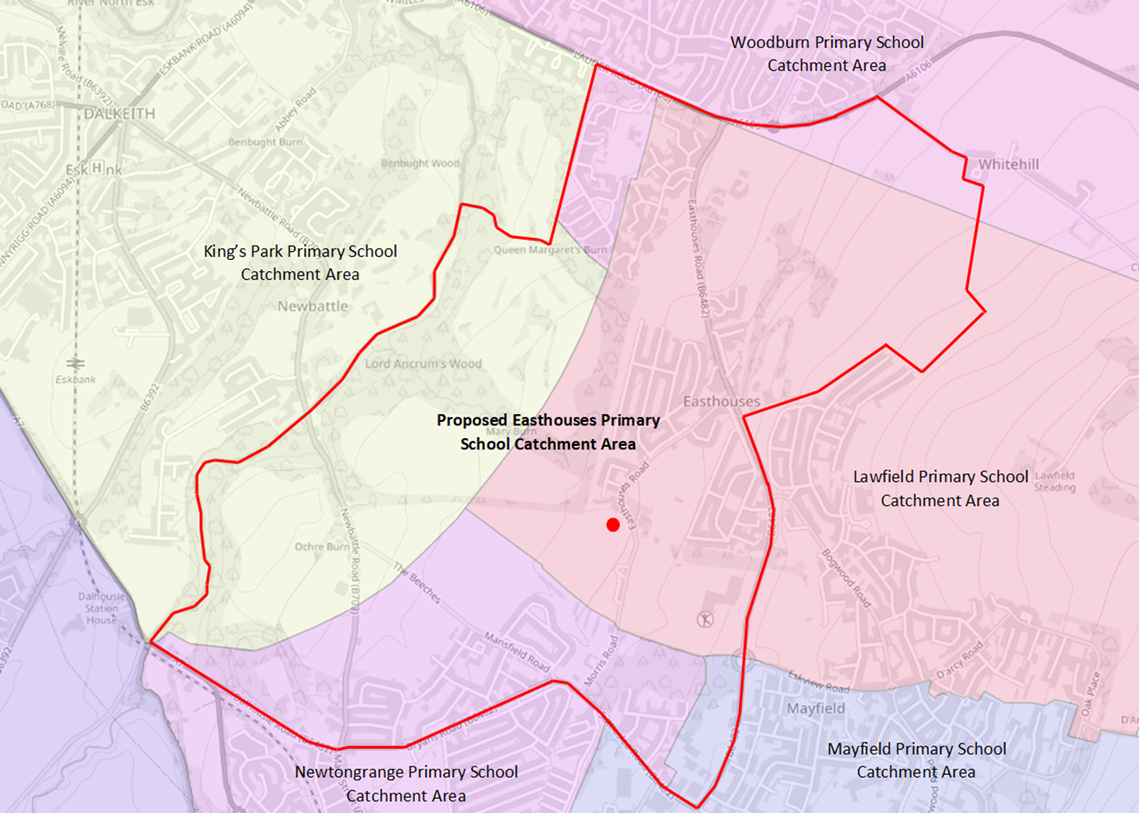

Slide 13
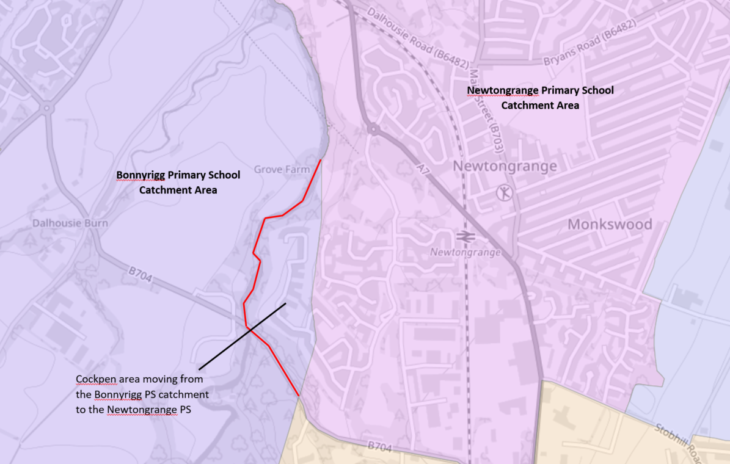

Slide 15
Context
Midlothian’s Learning Estate Strategy 2017 – 2047 (Update):
The Learning Estate is a significant and valuable resource for the communities of Midlothian.
Education remains a key priority for the Council and The Learning Estate Strategy plays an integral role in supporting the National Strategy and informs the Council’s Strategic Priorities.
The Strategic Plan commits to increasing skills for learning, life and work as well as enhancing life opportunities, aligning with the national aim to give every child and young person the best possible start in life.
The Learning Estate Strategy seeks to provide improved, flexible and adaptable learning environments to deliver 21st century education as part of a wider place making agenda. This vision is key to meet the principles of Scotland’s Learning Estate Strategy and to address the three key national education and skills priorities:
  1. Getting it Right for Every Child (GIRFEC)
  2. Curriculum for Excellence (CfE)
  3. Developing the Young Workforce (DYW)

Slide 16
Our Vision
The Council is ambitious for the future of Midlothian. By working together as a Community Planning Partnership, individuals and communities will be able to lead healthier, safer, greener and successful lives by 2030. No child or household need live in poverty. Midlothian will be a Great Green Place to Grow by achieving our net zero carbon ambitions
Our outcomes for the next 5 years are:
  Individuals and communities have improved health and learning outcomes
  No child or household living in poverty
  Significant progress is made towards net zero carbon emissions by 2030
We continue to aspire to deliver a world-class education system through equity and excellence. Our vision is to provide the highest quality inclusive education, learning and employability service for all individuals and families in Midlothian.

Slide 17
Context
Easthouses forms the Northern extension of the settlement of Mayfield, lying to the east of Dalkeith and the north of Newtongrange. There is rural farmland to the north east and parks, woodland and a golf course to the west.
The proposed site of the Easthouses Primary School is located on the old grounds of the Newbattle High School, which has been relocated across Easthouses Road to the East. The proposed site offers stunning views to the West of the site and a visual and physical connection to the residential estate to the South.
The new Easthouses PS will provide a 21st century contemporary school with early learning and community provision for the growing Easthouses town population in this area of Midlothian. Educational demand has risen due to the planned expansion of the settlements of Easthouses, Mayfield, Newtongrange and Gorebridge.

Slide 18
Context
The new two stream school will provide places for:
  459 children
  an Additional Support Needs provision with 16 places, to support children with social, emotional or behavioural needs
  80 Early Years places.
  The development comprises of a 2-storey teaching block, dedicated Early Years facility and an Additional Support Needs (ASN) teaching area. Easthouses PS will benefit from a sports pitch, landscaped grounds, and associated car parking with a drop off area.
  A Head teacher has been appointed ahead of the delivery of the new school and will be responsible for establishing and leading a User Reference Group to support transition arrangements, development of the school’s identity within the wider community and support families affected by the proposal.

Slide 19
Context: Cockpen, Newtongrange
In the process of creating the proposed new Easthouses PS catchment area the historical catchment boundary issue surrounding the Cockpen area of Newtongrange was identified.
The proposal to realign the Cockpen area of Newtongrange from the Bonnyrigg PS catchment area to the Newtongrange PS catchment area will align this area with its settlement and ensure that the catchment boundary will not split streets in the area.
It is proposed that the Newtongrange PS catchment area be extended to the South Esk River to take in the entirety of this area.

Slide 20
ASN Provision
The proposed Easthouses PS will contain 16 places for ASN provision, currently designed to support children with social, emotional or behaviour needs.
The new provision will provide a high-quality nurturing, learning environment. It will comprise of two class bases with their own access to a secure garden, nurture rooms, social/dining area, a sensory room and a life skill base.
The Education Resource Group will continue to allocate places to the specialist provisions based on assessment of needs.

Slide 21
Early Years Provision
The proposed Easthouses PS will contain 80 places for early learning and childcare in a dedicated Early Years facility.
The new nursery provision will be designed to meet the unique early learning and childcare entitlements of children aged 3-5. The design will include a range of flexible spaces for children.
There are no nursery catchment areas in Midlothian and this will also apply to the early learning and childcare facility at the proposed Easthouses PS.

Slide 22
Educational Benefits
  In summary there will be educational benefits as a result of the new school and catchment changes that will enhance:
  Inclusion;
  Early Learning and Childcare;
  the Local Community;
  Environment for Learning;
  Curriculum and;
  Learning and Teaching

Slide 23
Educational Benefits: Inclusion and Early Years
The provision for additional support needs will benefit pupils by meeting their social, emotional and behavioural needs. Thoughtfully designed spaces will better support children with additional support needs, keeping them with their peer group and supporting these children and families within their catchment and community. Where relevant, the school will promote opportunities for effective integrated working with other services and partner agencies to provide support to children and families.
Children within mainstream will benefit from the specialist staff sharing effective practice to support their learning and additional support needs.
The indoor playroom provision will provide an attractive, high quality learning environment that will offer a variety of contexts for learning with an indoor environment that will allow free flow play into the outdoors.
The provision of nursery on the site will develop working across the early level of curriculum for excellence and support transitions into primary school with a seamless progression in learning from nursery to P1.

Slide 24
Educational Benefits: Environment for Learning and the Local community
The new primary school will be designed and built to accommodate 21st century learning. Experience in previous new primary school buildings has demonstrated that a new and flexible learning environment has inspired and motivated pupils and has a positive impact on the general health and wellbeing of learners.
Carefully designed spaces for families and professionals to meet together will enhance learning experiences for children and help children and families reach their full potential, welcoming and fully involving families in the life of the school.
The accommodation will include purpose-designed facilities including sports and recreation facilities, dining areas, digital technology, dance studio and other learning resources. There will be a number of grass sports pitches and an All Weather Pitch.
Children in the Cockpen area of Newtongrange will have the opportunity to attend primary school with children in their settlement and have more involvement in the learning community where they live.

Slide 25
Educational Benefits: Curriculum and Learning and Teaching
The shared flexible learning and teaching spaces in the new school will enable staff to work together in a collaborative manner and provide more opportunities for co-operative working between pupils.
Learning and teaching approaches will include the use of modern, digital approaches to enhance learning experiences.
The new school will promote skills for learning, life and work and deliver positive outcomes for children in a modern well equipped environment
The new primary school will provide an opportunity for the curriculum to be designed for and with learners, parents and the community which is relevant and takes into account the context of the community.

Slide 26
Staff
  A Head Teacher has already been appointed to lead on the establishment and development of the school and its learning community, in partnership with parents/carers, pupils and key partners.
  It is acknowledged that should the proposal be approved and implemented, forward planning will be required from the Education Service as a matter of good management practice in ensuring the required staffing is in place. Staffing arrangements for the new primary school and ELC setting will be consistent with Midlothian Council’s recruitment policies and other local arrangements.
  The proposed increase in specialist staff supporting the provision working closely within a mainstream building would be advantageous and provide more effective support to the career-long aspirations of staff. In particular, mainstream staff will benefit from the expertise of specialist staff in upskilling in inclusive pedagogy.
  The new primary school will join the Newbattle HS associated school group and staff will benefit from the strong culture of collaboration and joint planning within this associated school group.

Slide 27
Transition Arrangements
Subject to the decision of Midlothian Council, children living in the proposed Easthouses Primary catchment area would be eligible to enrol for P1 at the school from November 2023, with the view to attending the school from it’s opening in August 2024 or as soon as possible thereafter.
Children who move into the catchment area from stages P2-7 would be eligible to attend the new school on it’s opening in August 2024 or as soon as possible thereafter.
Children currently attending their current catchment school would have the option to transfer to the new school if they chose, however they would also have the option to remain at the school they are currently attending.
Children living in the proposed new catchment area attending another school of their parents’ choice will have the option to transfer to the new primary school when it opens, or remain at the school currently attended.
No pupils will be required to move school if that is not their parents’ wish.

Slide 28
Transition Arrangements
Those children who are currently in the area of Cockpen and attend Bonnyrigg Primary School would be eligible to attend Newtongrange Primary School from August 2023. Any child living in this area who currently attends Bonnyrigg PS or Lasswade HS will be able to remain at those schools.
Pupils who are currently attending their current catchment school and are due to attend secondary school within 3 years of the catchment changes will be allowed to attend either their previous or new catchment secondary school.
Pupils whose secondary catchment area will change as a result of these proposals and who have a sibling that will attend their previous catchment secondary within three years of the catchment changes will have the option to attend either their new or previous school.
It is proposed that there will be no change to the current process for referrals and the allocation of specialist primary support spaces.

Slide 29
Easthouses Primary School Transition
Current Year Group
2022/23 | 2023/24 | 2024/25 | 2025/26 | 2026/27 | 2027/28
 |  | 2 years old
 |  | ELC*(Ante Pre-school) | ELC*(Ante Pre-school)
 |  | ELC*(Pre-school) | ELC*(Pre-school) | ELC*(Pre-school)
P1 | P1 | P1 | P1 | P1 | P1
P2 | P2 | P2 | P2 | P2 | P2
P3 | P3 | P3 | P3 | P3 | P3
P4 | P4 | P4 | P4 | P4 | P4
P5 | P5 | P5 | P5 | P5 | P5
P6 | P6 | P6 | P6 | P6 | P6
P7 | P7 | P7 | P7 | P7 | P7
Legend:
 | Children will have the choice of Newbattle HS or Dalkeith HS
 | Children will attend Newbattle HS, but can make a placing request for their former catchment secondary school.
 | Children may attend their previous primary catchment school if they already have a sibling attending that school. Otherwise they will attend the new school.
 | Not affected

Slide 30
Bonnyrigg and Newtongrange PS Transition
Current Year Group
2022/23 | 2023/24 | 2024/25 | 2025/26 | 2026/27
 | 2 years old
 | ELC*(Ante Pre-school) | ELC*(Ante Pre-school)
 | ELC*(Pre-school) | ELC*(Pre-school) | ELC*(Pre-school)
P1 | P1 | P1 | P1 | P1
P2 | P2 | P2 | P2 | P2
P3 | P3 | P3 | P3 | P3
P4 | P4 | P4 | P4 | P4
P5 | P5 | P5 | P5 | P5
P6 | P6 | P6 | P6 | P6
P7 | P7 | P7 | P7 | P7
Legend:
 | Children will have the choice of Newbattle HS or Lasswade HS
 | Children will attend Newbattle HS but can make a placing request for their former catchment secondary school.
 | Children may attend their previous primary catchment school if they already have a sibling attending that school
 | Not affected

Slide 31
Project Timeline
Proposal to establish a new primary school and its associated catchment area within the land at Easthouses and to realign the catchment areas of Dalkeith High School, Newbattle High School and Lasswade High School.
Consideration by Council
June 2023
Change to the catchment areas of King’s Park, Lawfield Mayfield, Newtongrange and Woodburn PS
August 2024
Change to the catchment areas of Dalkeith and Newbattle HS
August 2024
Change to the catchment areas of Bonnyrigg and Newtongrange PS
August 2023
Changes to the catchment areas of Lasswade and Dalkeith HS
August 2023
Statutory
Consultation
27 February to 23 April 2023
Final Consultation Report
Written after 23 April 2023

Slide 32
Questions?
For any further or more specific questions please email educationconsultation@midlothian.gov.uk

